Slide 1

#2239 Find Closest Number to Zero
Akhtamov Azimjon 2024299010
2025-01-09

Slide 2
Problem Definition (1)
Source: Leetcode
Title: Find Closest Number to Zero
Difficulty: easy
Type: Arrays

Slide 3
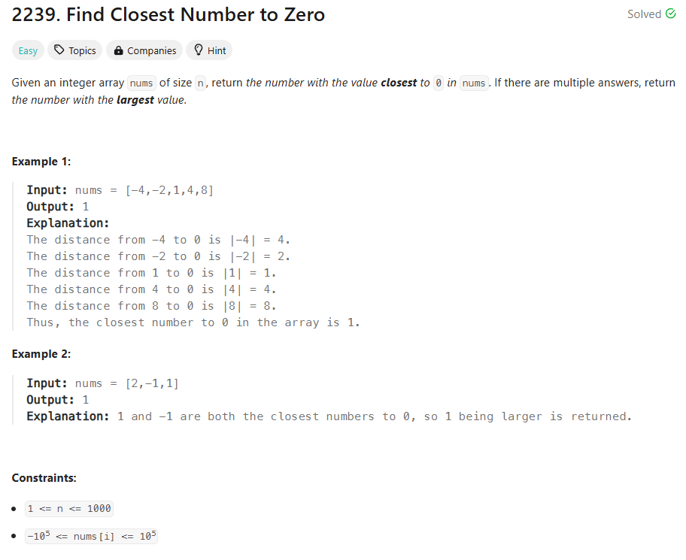
Problem Definition (1)

Slide 4
Solution (1)
nums[0]
closest = nums[0]
# 1st element in array
-4
-2
1
4
abs() in python
closest = x
# lowest element from 1st element
4
2
1
4
if closest >0 and abs(closest) in nums:
return abs(closest)
else:
return closest
I check also for negative and positive cases

Slide 5
Solution (2)
classSolution:
deffindClosestNumber(self, nums: List[int]) -> int:
closest = nums[0]
for x in nums:
if abs(x) < abs(closest):
closest = x
if closest < 0 and abs(closest) in nums:
return abs(closest)
else:
return closest
The time complexity is O(n): #operations
where n is the number of elements in the list nums.
This is because I need to inspect each number exactly once.
The space complexity is O(1): #selected 1 array
I am using a constant amount of space (the variable num) regardless of the size of the input list.

Slide 6
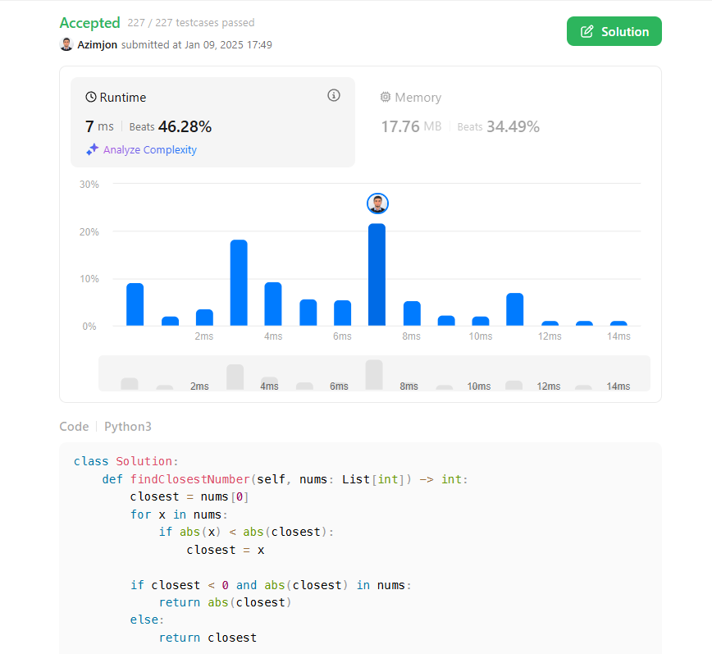
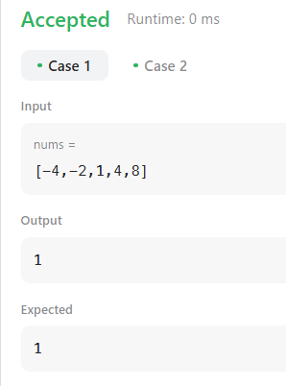
Solution (3)

Slide 7
What I have learned
Arrays:
I studied arrays and its functions to implement in Python
Time & Space Complexity:
I learnt how I can solve array problems for time & space in Big O notations. e.g. Number of operations in O(n), and space ....
I started challenge in 2025 to cover DSA based on ROADMAP : https://algomap.io/
+ I'll be tackling challenges and sharing my progress on Github
as I work through the roadmap provided by AlgoMap.io.

Slide 8
Questions and Answers

Slide 9
Greetings

